Slide 1

A
Technical Paper Presentation
On
Sentiment analysis using Telugu SentiWordNet
BACHELOR OF TECHNOLOGY
In
COMPUTER SCIENCE AND ENGINEERING
By
D S RITHIK (197R1A05K3)
B SWAPNIL(197R1A05J7)
ANKIT PATEL (197R1A05J5)
Under the Guidance of
J NARASIMHARAO
(Associate Professor)

Slide 2
ABSTRACT:
In recent times, sentiment analysis in low resourced languages and regional languages has become emerging areas in natural language processing. Researchers have shown greater interest towards analyzing sentiment in Indian languages such as Hindi, Telugu, Tamil, Bengali, Malayalam, etc.
Objective sentences are treated as neutral sentiment as they don't carry any sentiment value. Next, Sentiment Classification has been done where the subjective sentences are further classified into positive and negative sentences. With the existing Telugu SentiWordNet, our proposed system attains an accuracy of 74% and 81% for subjectivity and sentiment classification respectively.

Slide 3
EXISTING SYSTEM:
The existing system detects only that sentence is positive or negative
The existing system does not provide ratio of positive, negative and neutral sentence.
The Existing system was not accurate up to the mark and users were find difficult to get which one is positive and which one is negative sentence.
The existing system failed to detect the sentiment from sentence which is positive and which is negative due to which many confusion arises.
It identifies subjectivity classification where sentences are classified as subjective or objective. Objective sentences are treated as neutral sentiment as they don't carry any sentiment value. Next, Sentiment Classification has been done where the subjective sentences are further classified into positive and negative sentences.

Slide 4
DISADVANTAGES:
The existing system detects only that sentence is positive or negative sentence
The existing system doesn’t determine the ratios of the words in a sentence.
To avoid all these limitations and make the work more accurate the system needs to be implemented efficiently.

Slide 5
PROPOSED SYSTEM:
Here we build an application for detecting positive or negative sentences from Telugu sentences, this detection consists of two parts in which using first part we can detect objective or subjective from sentences and if objective words appear in the neutral list of SentiWordNet then that sentence will be consider as Neutral, if words not appear in SentiWordNet Neutral list then sentence words will check inside positive and negative list of SentiWordNet, if sentence words found in positive list then sentence will be consider as positive otherwise negative.
The proposed system for sentiment analysis has attained an accuracy of 74% for subjectivity classification and 81% for sentiment classification in the domain of news data

Slide 6
ADVANTAGES:
The system is very simple in design and implementation. The system
requires very low system resources and the system will work in almost
all configurations. It has got the following features.
This help in analysis of positive/negative/neutral sentence.
If sentences contains words from both positive and negative list then we take ratio of both positive and negative words and if positive ratio higher then sentence will be consider as positive else negative
The system implements Support Vector Machines(SVM) algorithm where it is used to classify text into positive, negative or neutral sentiments

Slide 7
HARDWARE REQUIREMENTS:
For the development of the application, the following are the Hardware Requirements:
System Architecture : 64-bit X86 with windows or Linux
CPU : Intel core 2 Quad CPU Q6600 @2.40GHz or greater
RAM : 4GB or greater
SOFTWARE REQUIREMENTS:
Operating System : Windows 7 or Greater
Coding Language : Python 3.7 version
Tool : Jupiter, Chrome Browser, Anaconda

Slide 8
NOVELTY:
The novelty of the projects is detecting positive or negative sentences from Telugu sentences, this detection consists of two parts in which using first part we can detect objective or subjective from sentences and if objective words appear in the neutral list of SentiWordNet then that sentence will be consider as Neutral, if words not appear in SentiWordNet Neutral list then sentence words will check inside positive and negative list of SentiWordNet, if sentence words found in positive list then sentence will be consider as positive otherwise negative.
This project take help of available Telugu SentiWordNet to perform sentiment analysis for Telugu eNewspapers sentences. The proposed system for sentiment analysis has attained an accuracy of 74% for subjectivity classification and 81% for sentiment classification in the domain of news data

Slide 9
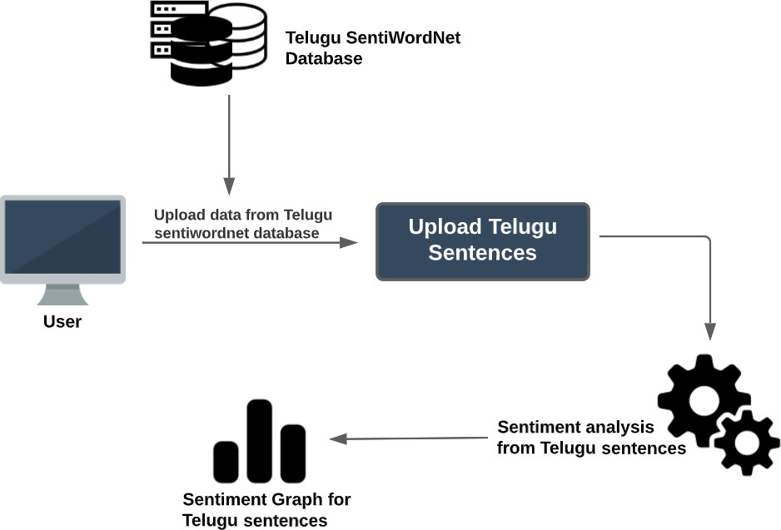
ARCHITECTURE
ARCHITECTURE DIAGRAM FOR SENTIMENT ANALYSIS USING TELUGU SENTIWORDNET

Slide 10
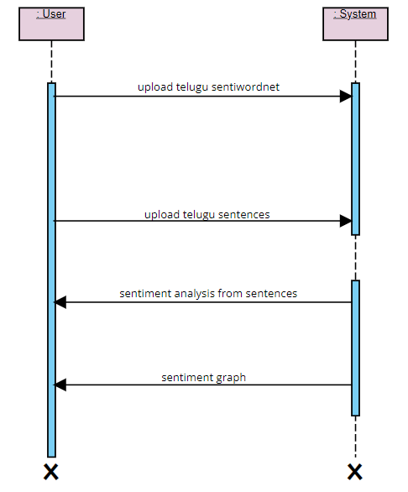
SEQUENCE DIAGRAM
1.
2.
3.
4.
SEQUENCE DIAGRAM FOR SENTIMENT ANALYSIS USING TELUGU SENTIWORDNET

Slide 11
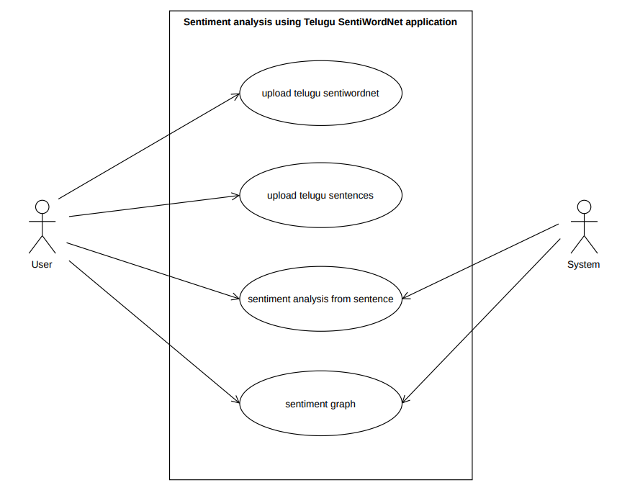
USE-CASE DIAGRAM
USE-CASE DIAGRAM FOR SENTIMENT ANALYSIS USING TELUGU SENTIWORDNET

Slide 12
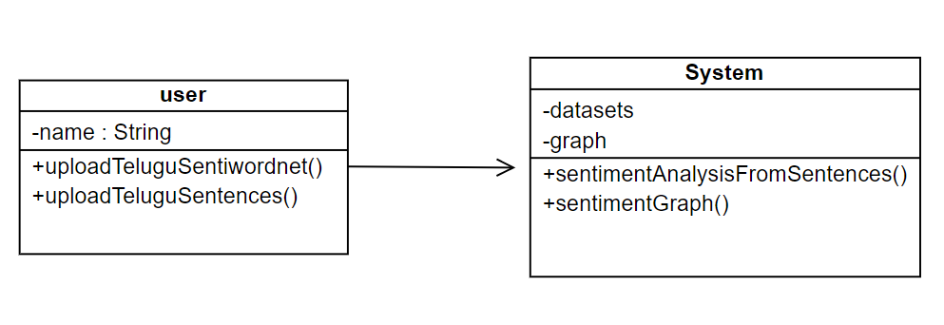
CLASS DIAGRAM
CLASS DIAGRAM FOR SENTIMENT ANALYSIS USING TELUGU SENTIWORDNET

Slide 13
SAMPLE CODE
global neg
global neu
global fscore
global pos_count
global neg_count
global count
def uploadSentiwordnet():
text.delete('1.0', END)
text1.delete('1.0', END)
text2.delete('1.0', END)
text.insert(END,"Sentiment Negative Words List\n\n");
text1.insert(END,"Sentiment Neutral Words List\n\n");
text2.insert(END,"Sentiment Positive Words List\n\n");
with open("Telugu_SentiWordNet/TE_NEG.txt", "r",encoding="utf-8") as file: #reading LIWC dictinary
from tkinter import *
import tkinter
from tkinter import filedialog
from tkinter.filedialog import askopenfilename
from tkinter import simpledialog
import numpy as np
import matplotlib.pyplot as plt
main = tkinter.Tk()
main.title("Telugu Sentiment Detection Using SentiWordNet") #designing main screen
main.geometry("1300x1200")
global filename
positive_list = []
negative_list = []
neutral_list = []

Slide 14
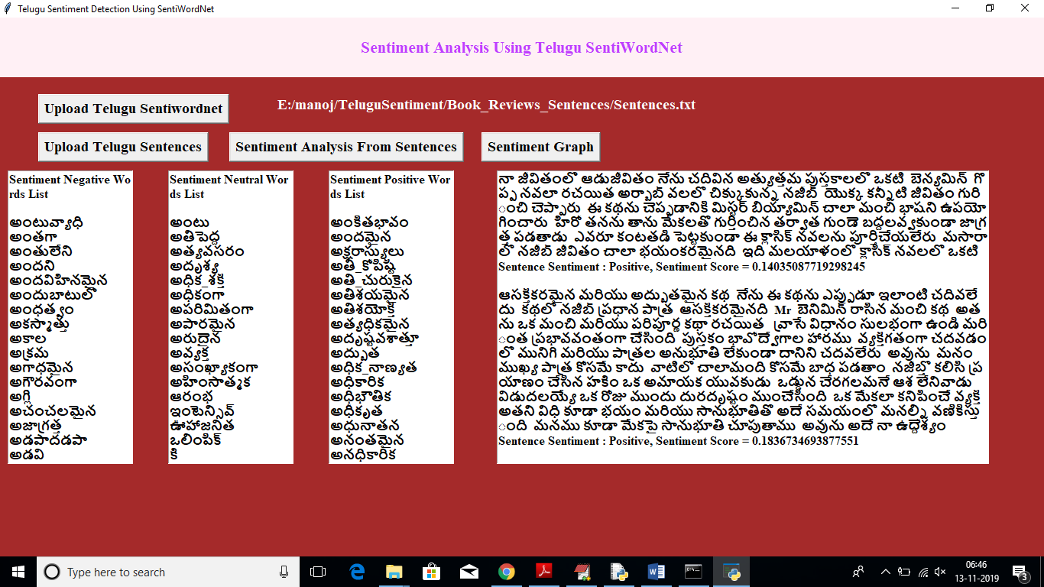
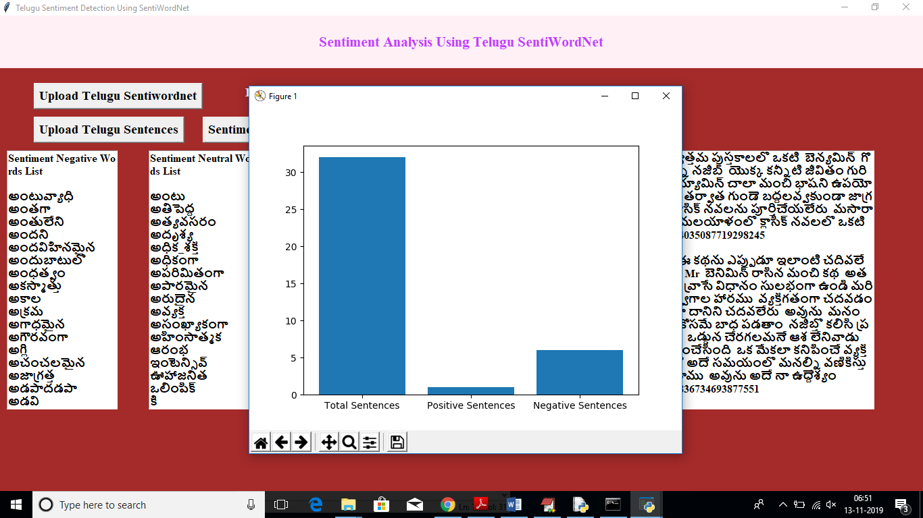
RESULTS

Slide 15
CONCLUSION:
In this project we build an application for detecting positive or negative sentences from Telugu sentences, this detection consists of two parts in which using first part we can detect objective or subjective from sentences and if objective words appear in the neutral list of SentiWordNet then that sentence will be consider as Neutral, if words not appear in SentiWordNet Neutral list then sentence words will check inside positive and negative list of SentiWordNet, if sentence words found in positive list then sentence will be consider as positive otherwise negative In Telugu languages, it’s hard to find annotated data set to perform NLP tasks such as POS tagging, sentiment analysis, sarcasm analysis, text summarization, etc. There are few annotated datasets available in this language.
This exploits the available Telugu SentiWordNet to perform sentiment analysis for Telugu e-Newspapers sentences. The proposed system for sentiment analysis has attained an accuracy of 74% for subjectivity classification and 81% for sentiment classification in the domain of news data.

Slide 16
THANK YOU

